Slide 1
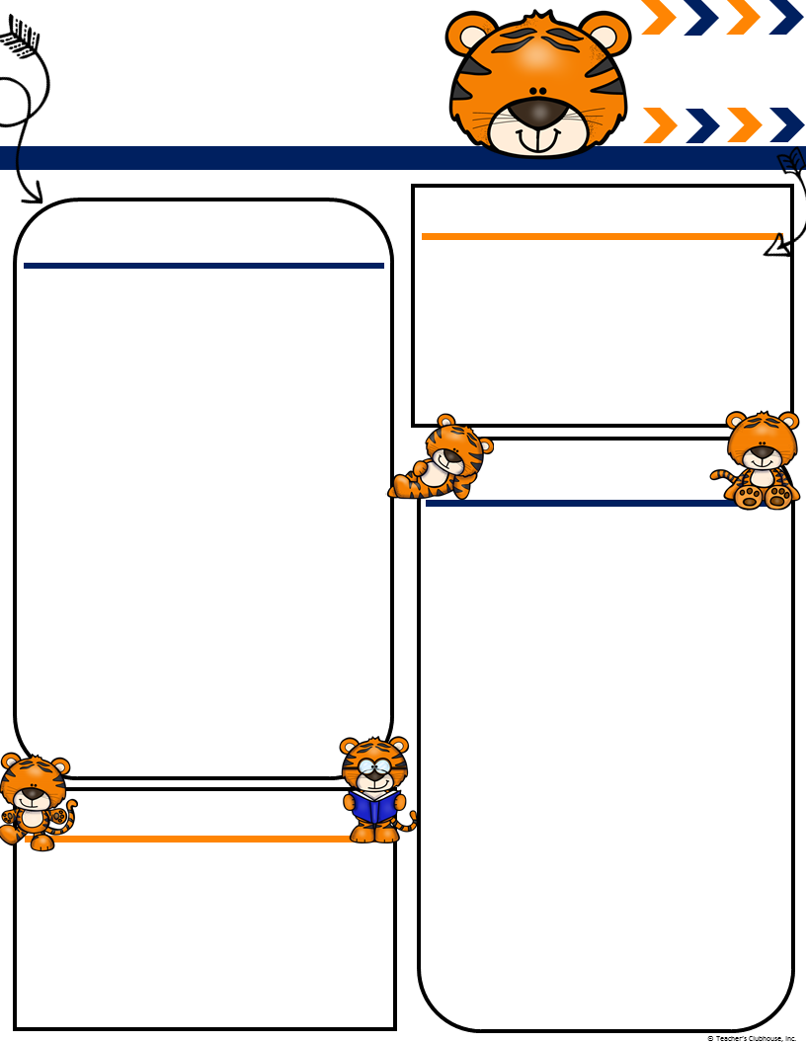
Ingalls’
September
cingalls@wcpss.net
mingalls.weebly.com
Terrific Tigers
Important Events
What We Are Learning!
No School Labor Day 3rd
PTA Spirit Night Marco’s Pizza 4th
Run Club Begins 7th
Guest Author 13th
Marina’s Birthday 17th
Early Release 28th
Literacy- Reading the Recess Queen and Stand Tall Molly Lou Melon. We will be working on answering various questions relating to the book. Your children will be learning to infer, visualize, connect, predict and retell these stories
Writer’s Workshop- Becoming successful writers. A successful writer sounds out their words, takes their time and draws and labels pictures.
Math- Number formation 1-20. Measuring with non standard units and sorting.
Social Studies: Citizenship
Science: Force and Motion.
Sight Words: These are the sight words that should be mastered by the end of quarter one. Continue to work on sight words daily to help your children master them!
I, a, is, to, it, on, at, in, be, of, as, he
Volunteers
If you would like to be a chaperone for field trips or to volunteer in the classroom you will need to complete the volunteer page on a computer in the Media Center. It cannot be done from home and it takes about 2 weeks to process. Our first field trip will be in October.
Community Snack
Please visit my website to find out more information and consider donating towards our community snack, please remember all snacks must be store bought ! ☺ We currently have 17 kids in our class..
Recess
Please remember to send water bottles to school. It is still hot out when the children are playing during recess and we want them to stay hydrated! Since all kindergarten teachers are outside for recess we cannot send them in for water without supervision.
Ms. Ingalls
Classroom Needs
Our class will be using the following books during guided reading. The Recess Queen by Alexis O’Neil, Scaredy Squirrel by Melanie Watt and Bear Snores On by Karma Wilson. If you would like to donate any of these books to the class that would be greatly appreciated.

