Slide 1
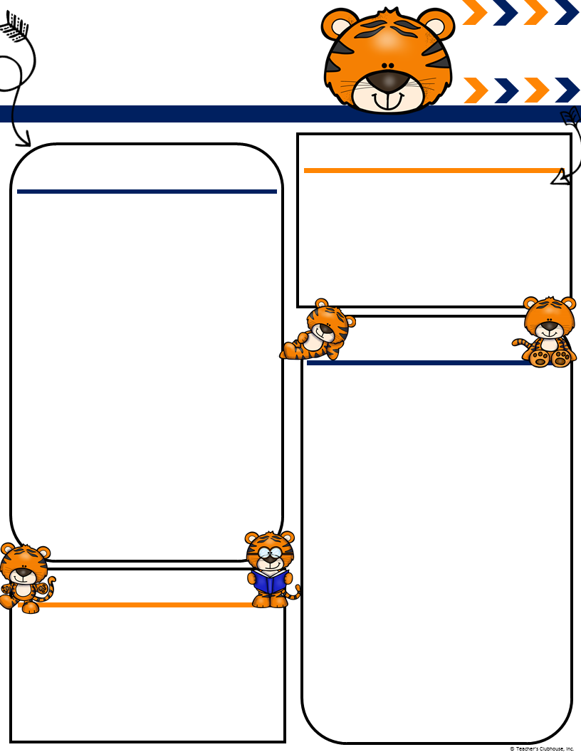
Ingalls’
January
cingalls@wcpss.net
Msingalls.weebly.com
Terrific Tigers
Important Events
What We Are Learning!
Back to School 2nd
Clemson plays in National Championship 7th GO TIGERS!!!!
Ms. Ingalls Birthday 10th
No School MLK JR. Day 21st
Track Out 25th
Literacy- We will be starting our “Gumballl sight words” program on Monday, January 7th. Your children will be sent home with a list of words every Monday. It will either come with a certificate because they passed or a list of words to study. The retest will be on Fridays. If they pass on Friday they will get a certificate if not they will retake the test again on Monday.
Math- Reviewing counting objects to 20 by subitizing. We will begin to introduce parts and wholes of numbers.
Science- Beginning our unit “Weather” and understanding the different types of weather.
We have had many accidents lately. Please make sure you have sent in an extra set of winter clothes for your child to have in case of an emergency. Please tell them to leave them in their cubbies. If there is an accident we will send the dirty clothes home in a bag. Please resend in clothes the next day to keep in cubby. If we have sent your child home with clothes from the office please wash them and send them back so we can return them to the office. Thank you!!
Ms. Ingalls
Classroom Needs
We still have plenty of snacks!!! We are in need of plastic utensils, Clorox wipes, paper towels, and paper plates. Thank you for all the thoughtful gifts you gave me before break!!! The gift cards came in handy!!!

