Slide 1
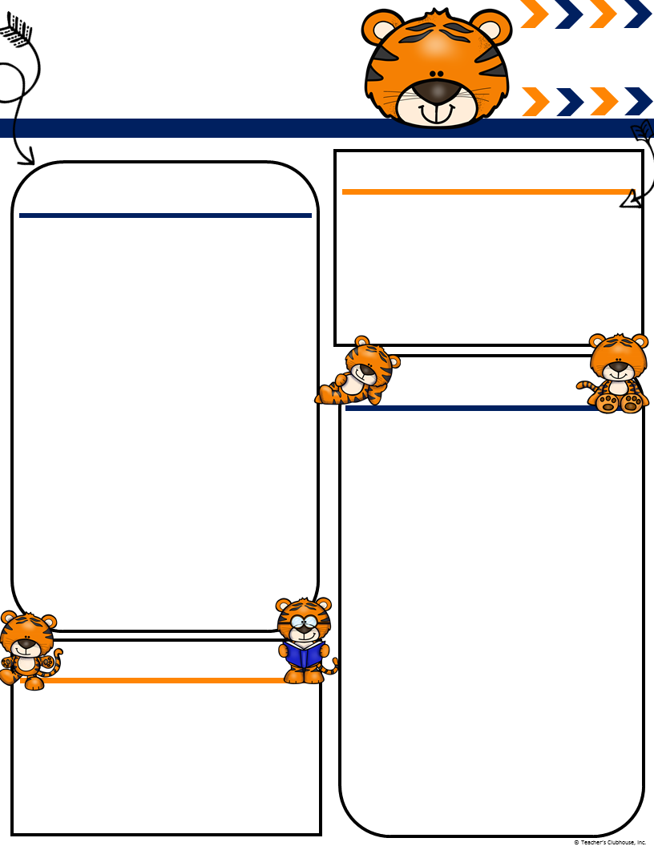
Ingalls’
February
cingalls@wcpss.net
Msingalls.weebly.com
Terrific Tigers
Important Events
What We Are Learning!
Track In 18th
Noel’s Birthday 19th
100th day of school 20th
Letterland Character Dress up Day 2oth
Literacy- We will continue our “Gumballl sight words” program on Monday, February 18th. Your children will be sent home a list of words every Monday it will either come with a certificate because they passed or a list of words to study. The retest will be on Fridays. If they pass on Friday they will get a certificate if not they will retake the test again on Monday.
Math- Begin learning how to decompose numbers and partners of 10.
Science- Continue our unit “Weather” and understanding the different types of weather.
Please make sure you have sent in an extra set of winter clothes for your child to have in case of an emergency. Please tell them to leave them in their cubbies. If there is an accident we will send the dirty clothes home in a bag. Please resend in clothes the next day to keep in cubby. If we have sent your child home with clothes from the office please wash them and send them back so we can return them to the office. Ask your child if they need new crayons. Some are down to just a few colors left in their pencil pouch. Thank you!!
Ms. Ingalls
Classroom Needs
We still have plenty of snacks!!! We are in need of plastic utensils, Clorox wipes, paper towels, and paper plates. The flu is going around the school so please if your child has any symptoms keep them home so we do not share the germs!!!!

