Slide 1
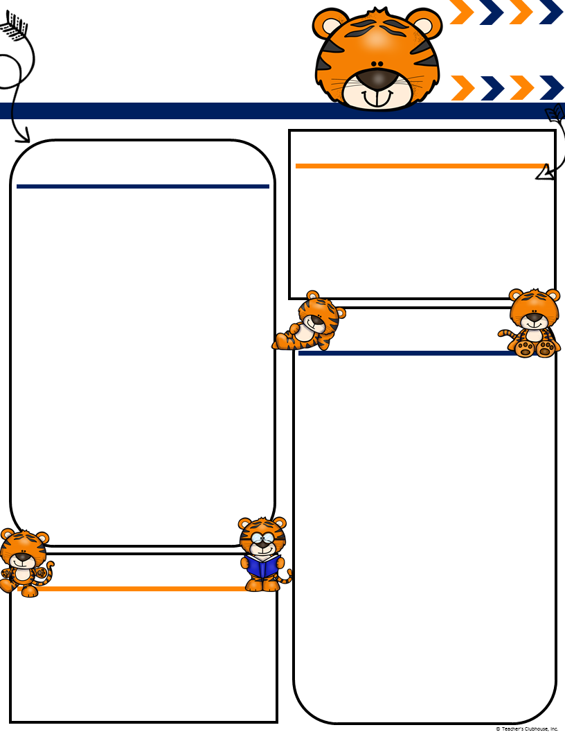
Ingalls’
December
cingalls@wcpss.net
Mingalls.weebly.com
Terrific Tigers
Important Events
What We Are Learning!
Book Fair Family Night 12th 5-7:30
Early Release 1:15 21st
Winter Break 24th-January 1st
Literacy- Continuing to recognize rhyming words and also learn to clap out syllables in words. Students will also continue working on sight words daily and reading books on their reading level. Continue to study those sight words weekly.
Math- Decomposing teen numbers(11-19). Introducing 2D shapes(circle, square, rectangle, triangle, hexagon) and understanding how to create each shape, as well as identifying attributes of each.
Social Studies- Continuing our wants and needs unit as well as learning about different holidays that are celebrated throughout the world.
Book Fair week continues! We went and previewed the books on the 3rd. Our buying day is on the 11th. Please send in the wish list with the items you want to buy marked in an envelope with the money. We still have a few dress up days. Thursday is dress like a storybook character. Friday is dress like a unicorn or dragon.
Ms. Ingalls
By the way December 29th…….GO TIGERS BEAT NOTRE DAME!!!!!!!!!!!!
Classroom Needs
Please check with your student and ask if their crayons are holding up. I have noticed a lot of students saying they are missing crayons or their crayons are broken. Don’t forget to send in a warm set of extra clothes in case of any accidents.

