Slide 1
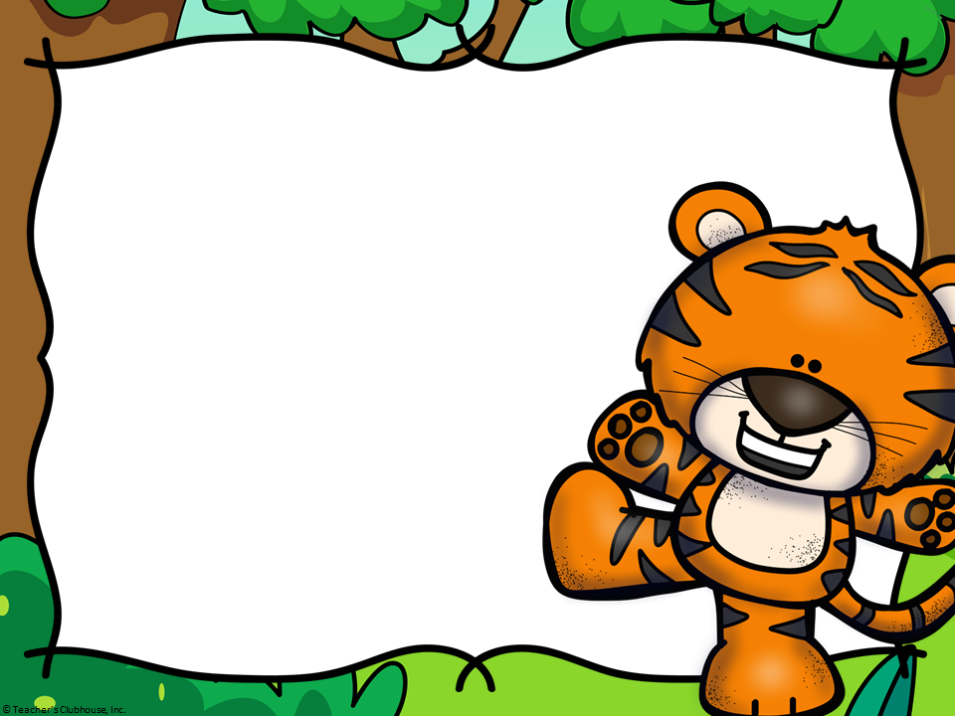
Welcome
Ms. Ingalls’
Classroom
2018-2019

Slide 2
Meet the Teacher
I have been at Carpenter since it opened in 2006. I have been teaching for 20 years. Kindergarten is by far my favorite grade level. The look in those little eyes when they first walk in and seeing them grow so much from the first day of school to the last day of school is the most rewarding feeling in the world. I have three kids of my own. Taylor is a Freshman this year at UNC Asheville, Bryce is a Freshman at Panther Creek High School and Ava is in Fifth grade at Highcroft.

Slide 3
Morning Arrival
Students may start entering the building at 8:45. The late bell rings at 9:15. We do morning work everyday so it is important to arrive as soon as you possibly can. Please refrain from walking your students down or sending them down with an
older sibling. The tears generally happen when
the parents walk the students down. I promise
they will be okay and will make it to class safely.

Slide 4
Math
Counting to 100
Recognizing and writing numbers 0 – 20
Subitizing – identifying a small amount of objects by sight (without counting) for groups of 1 – 5 items
Addition & subtraction with numbers up to 10
Decomposing numbers into tens and ones (for example, 17 is 1 ten and 7 ones)
2 and 3 dimensional shapes – identify, describe, & compare and contrast
Measurement – length and weight (nonstandard)
How will it be taught?
Whole group mini lessons
Math Journals
Math Tubs & “Teacher Table”

Slide 5
Reading
Please read with your child every day!
Print concepts (on separate hand out)
Sight Word practice is essential
Reading Strategies to decode words
Retelling stories & answering comprehension questions – oral & written
End of year goal is a level C/D

Slide 6
Letterland
Phonics based program to teach reading and writing.
Stories about Letterland characters help students learn phonics facts.
Begins with letter shapes and sound
Progresses to word building and common letter patterns.

Slide 7
Writing
Very developmental (please take note of handout)
Each child will write at different stages
Narrative, opinion, and expository
End of year goal is for students to produce 3 to 4 sentences on one topic
Phonetic spelling – encourage your child to write using the sounds they hear in words
Correct spelling of sight words
Writing conventions (capitalization, spacing, and punctuation)

Slide 8
Curriculum
North Carolina uses Common Core Standards
Complete list of standards can be viewed at www.corestandards.org
See “Things You Really Need to Know about Kindergarten” handout

Slide 9
Report Cards
Report cards go out at the end of every quarter.
mClass reading reports sent home at the beginning, middle, and end of the year.
Parent conferences will be held at the end of the 1st and 3rd quarters to discuss both social and academic growth.

Slide 10
Standards Based Grading
Level 1 – Does not understand or does not complete task
Level 2 – Inconsistently meets expectation or is approaching understanding
Level 3 – Can consistently & correctly do the task on his/her own (Level 3 is on grade level)
Level 4 – Consistently demonstrates an in-depth understanding and independently produces high quality work without any guidance or push.
Not every standard has a level 4 opportunity.

Slide 11
Weekly Routines
Chameleon Folders - Please send daily
Absences & Tardies
Changes in Transportation
Allergies
Lunch - $2.55 per day Please pre-pay if possible www.myschoolbucks.com

Slide 12
When To Stay Home
Fever of 100 or higher (fever free for 24 hours without medication before returning)
Red, watery eyes with yellow drainage
Nausea, vomiting, and/or diarrhea (vomit free for 24 hours)
Severe headache
Undiagnosed rash
Lice – Please contact us ASAP

Slide 13
Dismissal
Students will need to have a tag on their backpack to ride the bus.
If there is a change in transportation please send a note in your child’s folder that morning
or call the office.

Slide 14
Website
www.mingallsweebly.com
Newsletters
Schedule
Photos
Wish List
Volunteer & Snack Sign Up
Resources

Slide 15
Behavior Management
“Be like Cary!” Collaborative, Achieving,
Respectful, / Year-round Leaders
CARY Cards & Cary Tree
Go Tigers Behavior Clips

Slide 16
Homework
Homework will begin in August
Homework will come home on Mondays in Daily Folders.
Homework will be collected on Fridays.
Homework may require some assistance from a parent.
Consists of sight words and Math sheets

Slide 17
Volunteers
All volunteers MUST register in the Media Center prior to working in the classroom or attending field trips. Prepare for future volunteer opportunities by registering ASAP!
We will begin having volunteers in September
Volunteers can sign up on our class website by clicking on the “Volunteer” tab.
Always sign in at the front office as a volunteer before coming to the room.
Thank you for all you do to support our classroom!

Slide 18
Can You Remember All That
I know that we went over A LOT of information. Always remember that I am here for you & your family. Please don’t hesitate to call, send a note in your child’s folder, or send an e-mail with any questions or concerns. cingalls@wcpss.net

Slide 19
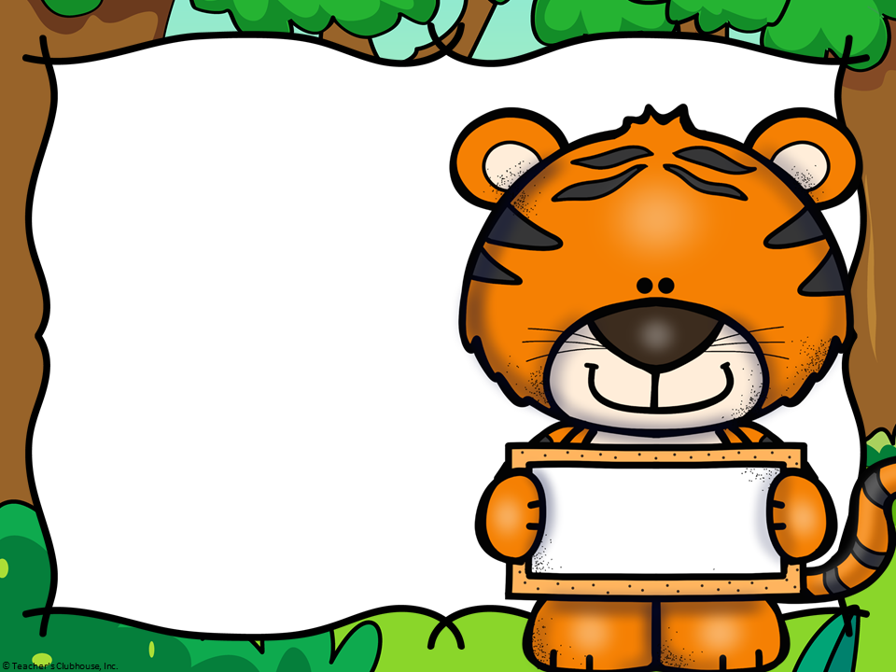
I look forward to working with you and your child this year. It will be a year of wonderful things
ahead!
Thank
You

