Slide 1
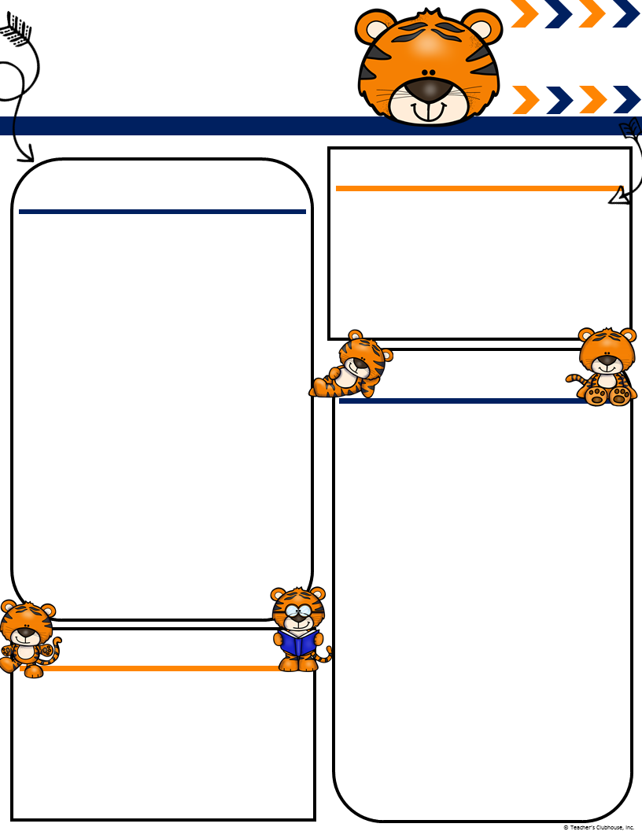
Ingalls’
October
cingalls@wcpss.net
mingallss.weebly.com
Terrific Tigers
Important Events
What We Are Learning!
4th Field Trip Pumpkin Patch
5th Aly’s Birthday & PTA Family Fun Night
11th Make up Pictures
14th Camp Chameleon Workday
19th Track Out
24th Vinny’s Birthday
30th Parent Academy Night 5:30-7:00
Literacy- While reading we will be focusing on retelling, making connections and visualizing pictures in our heads through various stories.
Writer’s Workshop- We are continuing to work on our sentence structure and making sure we have spaces between our words, an uppercase letter to start our sentences and a period to end.
Math- Working on our numbers 1-20, specifically focusing on composing and decomposing numbers 11-19.
Science: We will finish up our Forces and Motion unit and begin working on investigating properties.
We only had one parent volunteer to chaperone our field trip on October 4th. If you have registered to volunteer and would still like to go please let me know ASAP!
We had our first chance for parents to come in as a mystery reader. Keep an eye open for the next time(it will be when our Reader’s Theater class is canceled, probably will be some time in November.)
Conferences will be held on November 19th. I will have the sign up ready by the end of this week. It will be linked to the class website under sign ups.
Ms. Ingalls
Classroom Needs
Thanks to Marina’s family for donating our book buckets. It is nice to have all the notebooks, pencil pouches and folders out of the way. Thanks to Vinny’s family for donating three of the books we will be reading this year. There are still a few books on the wish list and we are in need of some Clorox wipes! We want to kill as many germs as we can!!

