Slide 1
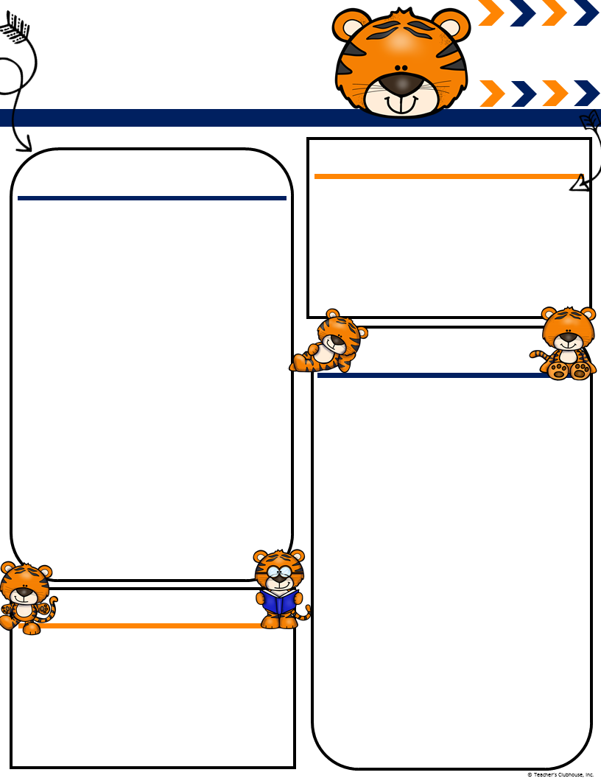
Ingalls’
JULY
cingalls@wcpss.net
Mingalls.weebly.com
Terrific Tigers
Important Events
What We Are Learning!
First Day of Kindergarten 16th
Parent Breakfast 16th 9:15
Emmanuel’s Birthday 2oth
Bryan’s Birthday 23rd
Camp Chameleon Workday 21st 3-5
Curriculum Night – 24th 5:00-6:30
Track Out 26th
July is a short and busy month for track 3 students! We will be going over our rules and routines and getting to know our school better!
Letterland- Introducing the letters and sounds for C, A, D, H, M, T, S, I, N
Writing- writing our names and holding the pencil correctly. These are VERY important skills to learn before beginning our writer’s workshop unit after track out!
Math- identifying numbers more than one way. (10, ten, 10 objects, etc)
I’m so excited to be your child’s Kindergarten teacher this year! We are going to be learning A LOT and having A LOT of fun too ☺ I will be sending home newsletters as well as posting them to my website(msingalls.weebly.com) to update you on what your child will be learning. In addition to my newsletters please check your emails daily for classroom updates and important information. Some important things I want to point out before the school year gets into full swing.
PLEASE let me know if your child will be going home a different way! You can do this by a written note in your child’s folder or calling the office. It is so important that I know this prior to dismissal
If your child is going to be missing school(sick,doctor’s appointment, family emergency, etc.) I need to know that as soon as possible.
Chameleon folders are sent home daily and should be returned daily.
I am looking forward to a great year! If you have any questions please email me! I will try my best to respond within 24 hours.
Ms. Ingalls
Books and Poems
Our class will read many books & poems, but these are some that we will be focusing on this month. Chrysanthemum by Kevin Henkes Chicka Chicka Boom Boom by Bill Martin Jr & John Archambault Poems” “Name Chant” “Time for School”

