Slide 1
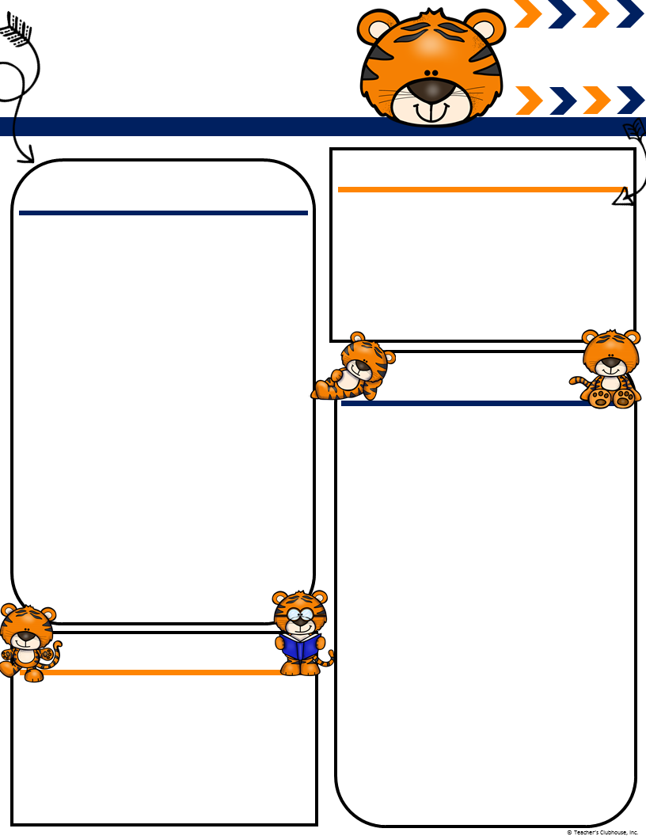
Ingalls’
August
cingalls@wcpss.net
Msingallsterrifictigers.weebly.com
Terrific Tigers
Important Events
What We Are Learning!
Letterland- We have completed our fast track portion of Letterland and will sonn be going more in depth with letters and their sounds, as well as handwriting.
Writing- We are continuing to add detail to our pictures as well as introducing labels.
Math- We will be working on identifying numbers up to 20 and introducing daily math talk and centers
Reader’s Workshop- We will be reading various stories and working on comprehension strategies like retell, infer, opinion, predictions and visualizing parts of a story.
Sight Words: WE are working on the following sight words this month:
I, a, is, to
Allison’s Birthday 12th
Track in 20th
Parent Curriculum Night 21st 5:00-6:30
Fall Picture Day 28th
Homework
Homework is sent home every Monday. The homework is not meant to be completed in one night and is due back on Friday. ☺
I have placed each child’s RAZ kids passwords as well as their student ID numbers on the left side of your child’s folders.
What is RAZ kids? RAZ kids is an app/website where your child can practice reading and reading comprehension. We have seen tremendous growth in the students that practice on RAZ Kids, even weekly!
Miscellaneous
Please send a water bottle for your child to take woth them when we go outside to play. We are allowed outside unless the temperature is above 94
We are underway with community snack and about to begin having mystery readers in the classroom! If you would like to helpl out please check our class website for more details!
Ms. Ingalls
Classroom Needs
A few students still need to bring in a pronged red folder. We use these for our poetry journals. I have bought 12 book boxes to hold the students notebooks and folders. I still need to purchase 12 more. I have a wishlist on Amazon if you would like to help us out. https://www.amazon.com/hz/wishlist/dl/invite/geC4D9G

